Slide 1




Project - 2
Sustainable Supply Chain Performance Dashboard in Power BI
By Manav Shah​

Slide 2
Internship Title: Shell-Edunet Skills4Future AICTE Internship | Green Skills using AI Technologies
Project Name:
Sustainable Supply Chain Performance Dashboard in Power BI
Intern Name: Manav Shah
AICTE Student ID: STU673dfdb22de4c1732115890
AICTE Internship ID: INTERNSHIP_1736246007677d02f700dbe

Slide 3
Learning Objectives
Learn the key principles of sustainable supply chain management.
Gain proficiency in creating interactive dashboards in Power BI.
Learn to import and integrate data from multiple sources, such as CSV files into Power BI.
Use advanced Power BI features like DAX calculations, measures, and calculated columns to derive insights.
Master the art of visual storytelling to effectively communicate sustainability performance to diverse audiences.

Slide 4
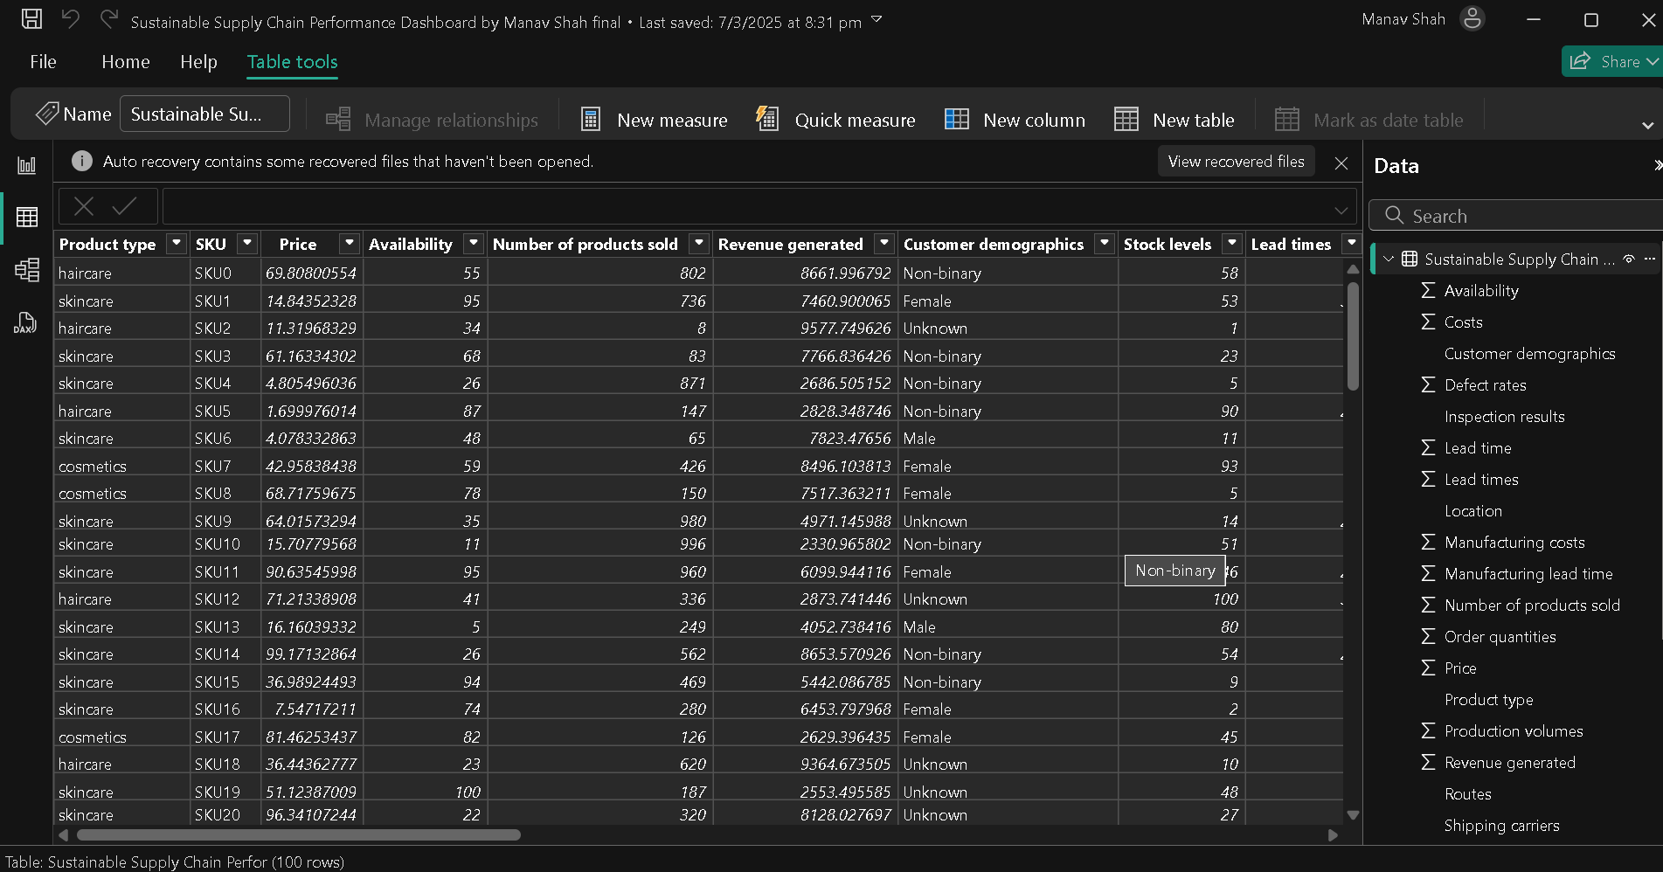
Week 1 Connect Dataset to Power BI

Slide 5
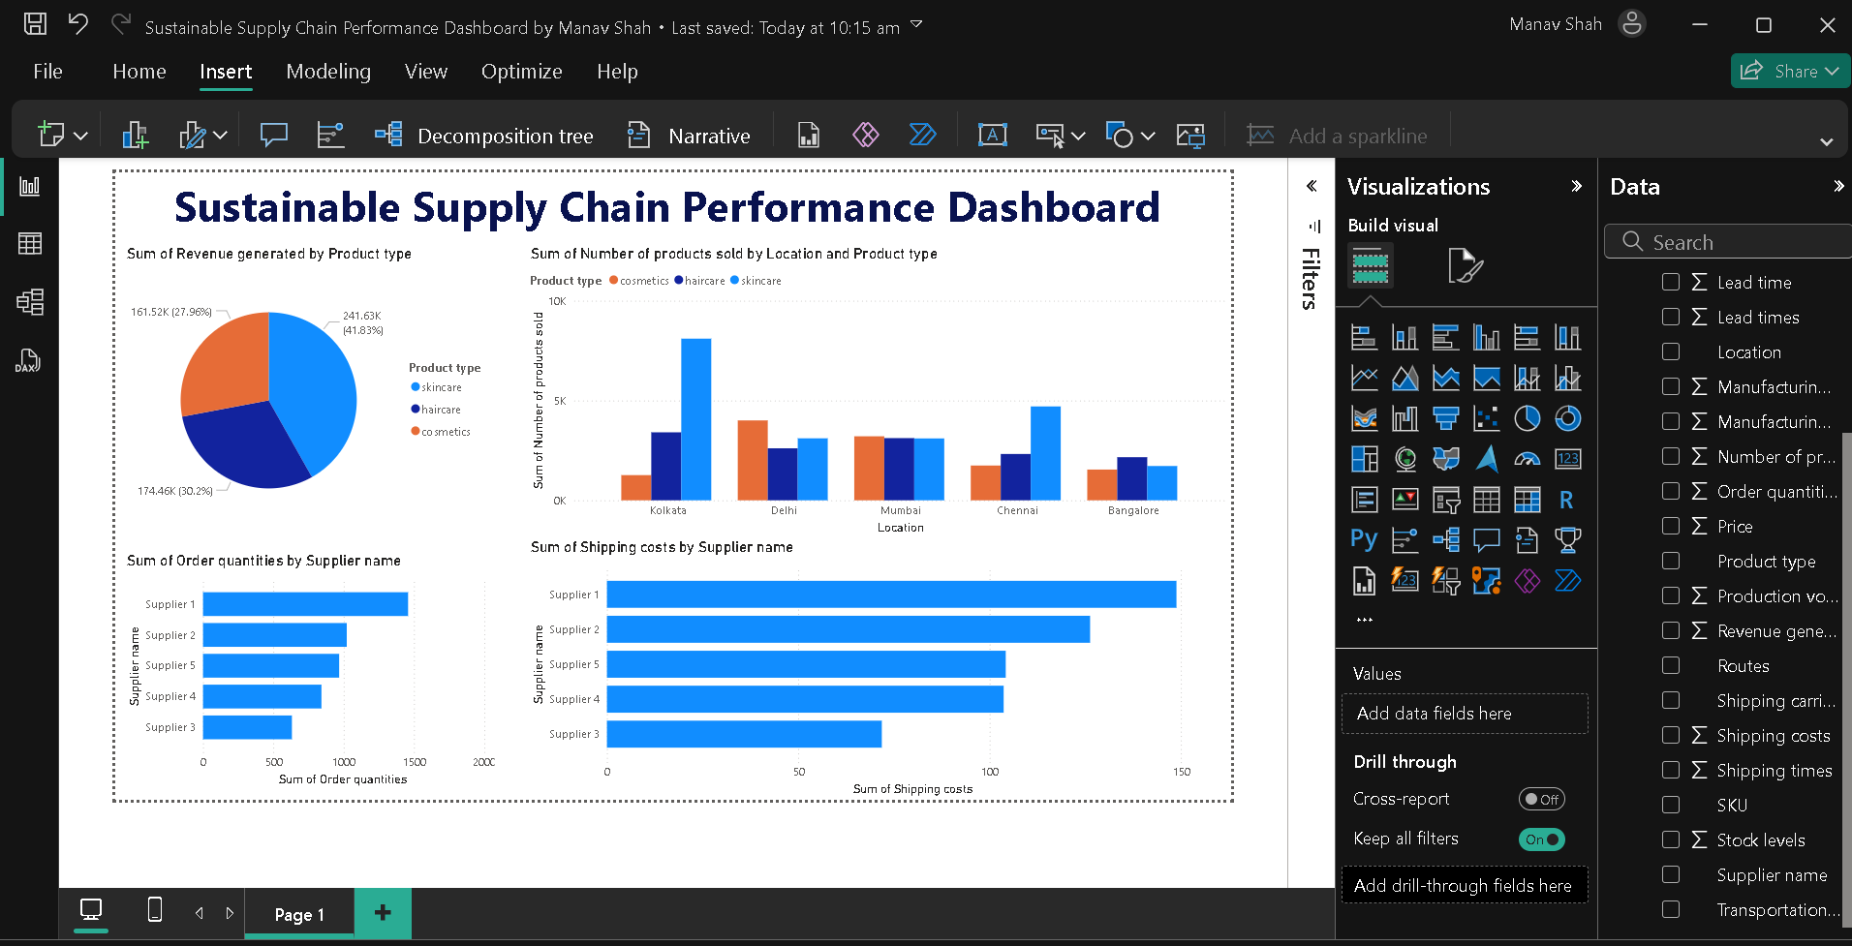
Week 2 Create Dashboard in Power BI​

Slide 6
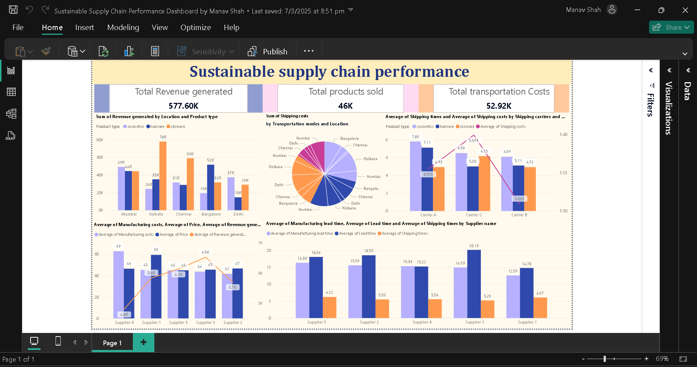
Week 3 Create Dashboard in Power BI​

Slide 7
Insights:
Revenue Breakdown
Total Revenue: 577.6K
Chennai has the highest revenue (79K) in Haircare, while other locations have a more balanced distribution across categories.
Mumbai and Bangalore generate more balanced sales across all three categories (Cosmetics, Haircare, Skincare).
Shipping & Transportation
Carrier A has the highest shipping costs (5.59 - 7.80) but slower delivery.
Carrier B is the most cost-effective (5.08 - 5.11), making it a better choice for reducing expenses.
Skincare products have higher shipping costs on average.
Supplier & Manufacturing Lead Times
Supplier 3 has the longest lead time (~20.13 days), potentially causing delays.
Supplier 2 has a shorter lead time (~6.22 days), making it more reliable.
Supplier 5 is also relatively efficient (~6.22 days).

Slide 8
Actionable Recommendations
Diversify product focus in Chennai. Since Haircare dominates, expanding Cosmetics and Skincare can increase revenue.
Shift more shipments to Carrier B to reduce costs while maintaining efficiency.
Consider reducing reliance on Supplier 3 due to long lead times, and prioritize Suppliers 2 and 5.

Slide 9
Summary
The project, "Sustainable Supply Chain Performance Dashboard in Power BI," focuses on developing an interactive and data-driven dashboard to analyze and improve supply chain sustainability. By integrating inventory, manufacturing, and supplier data, the dashboard provides real-time insights into revenue trends, transportation costs, and supplier performance.
This enables data-driven decision-making, helping businesses:
Optimize inventory management and supplier selection
Reduce transportation costs by choosing cost-effective carriers
Improve manufacturing efficiency by identifying suppliers with shorter lead times
Enhance supply chain sustainability through better resource allocation
This project demonstrates how Power BI can transform raw data into meaningful insights, supporting efficient and sustainable business operations.

Slide 10
References
https://community.fabric.microsoft.com/t5/Power-BI-forums/ct-p/powerbi
https://learn.microsoft.com/en-us/power-bi/create-reports/sample-sales-and-marketing
https://powerbi.microsoft.com/en-us/customer-showcase/
https://kaggle.com
https://learn.microsoft.com/en-us/power-bi/guidance/star-schema
Notes:
Reference: https://everhour.com/blog/what-is-github/

Slide 11
Thank You!
Notes:
Thank You !!

